Slide 1
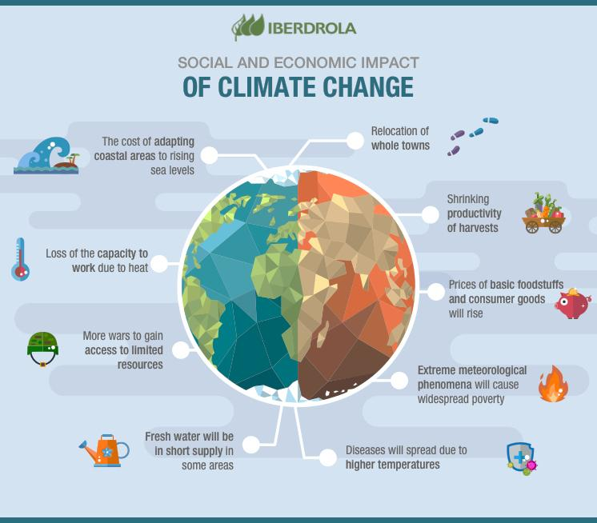
CLIMATE CHANGE IN PAKISTAN

Slide 2
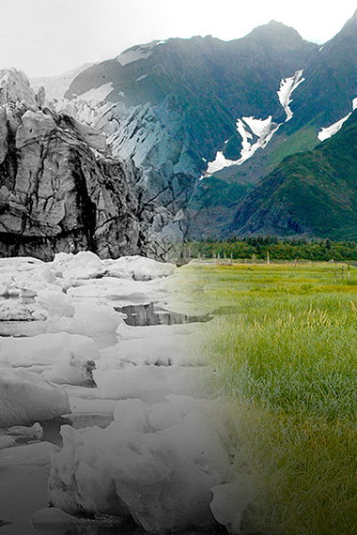
What is Climate Change?
According to the BBC Climate Asia report,
53% of Pakistanis felt that their lives had become worse off than they were five years ago.
ascribed changes in climate and extreme weather events to the will of God."
According to the Pakistan Economic Survey of 2014-15,
"increase in frequency and intensity of extreme weather events coupled with erratic monsoon rains causing frequent and intense floods and droughts"
By: KABEER AHMED

Slide 3
Causes Of Climate Change
Greenhouse Gas
Air Pollution
Waste
Deforestation

